Slide 1
12
The Central
Nervous System:
Part C

Slide 2
Functional Brain Systems
Networks of neurons that work together but span wide areas of brain
  Limbic system
  Reticular formation

Slide 3
Limbic System
Structures on medial aspects of cerebral hemispheres and diencephalon
Includes parts of diencephalon and some cerebral structures that encircle brain stem

Slide 4
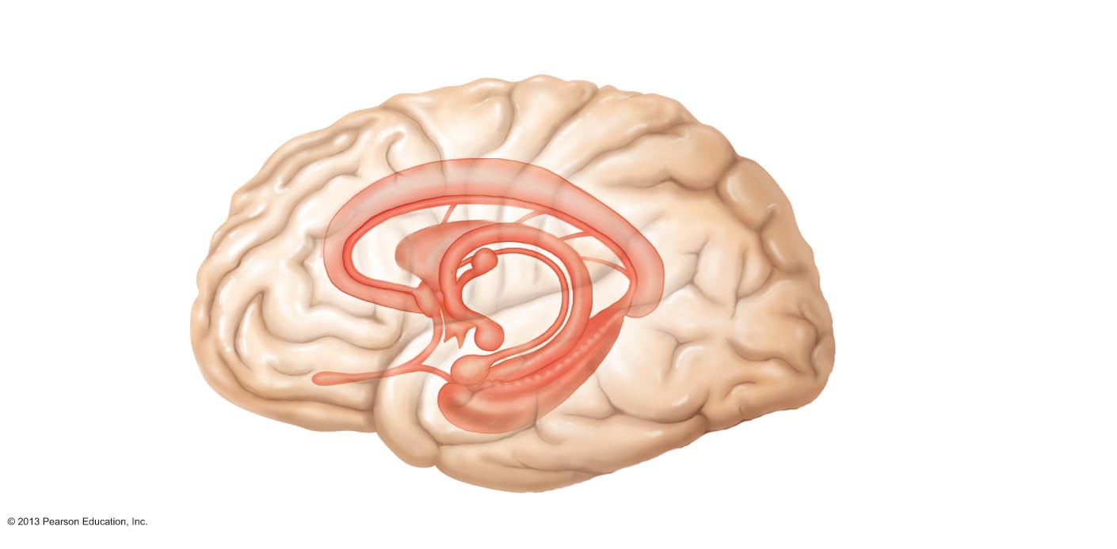
Figure 12.16 The limbic system.
Septum pellucidum
Corpus callosum
Diencephalic
structures of the
limbic system
Fiber tracts connecting
limbic system structures
Fornix
Anterior thalamic
nuclei (flanking
3rd ventricle)
Anterior commissure
Cerebral structures
of the limbic system
Hypothalamus
Cingulate gyrus
Septal nuclei
Mammillary
body
Amygdaloid body
Hippocampus
• Dentate gyrus
Olfactory bulb
• Parahippocampal
gyrus

Slide 5
Limbic System
Emotional or affective brain
  Amygdaloid body—recognizes angry or fearful facial expressions, assesses danger, and elicits fear response
  Cingulate gyrus—role in expressing emotions via gestures, and resolves mental conflict
Puts emotional responses to odors
  Example: skunks smell bad
Most output relayed via hypothalamus

Slide 6
Limbic System: Emotion and Cognition
Limbic system interacts with prefrontal lobes
  React emotionally to things we consciously understand to be happening
  Consciously aware of emotional richness in our lives
Hippocampus and amygdaloid body—play a role in memory

Slide 7
Reticular Formation
Three broad columns run length of brain stem
  Raphe nuclei
  Medial (large cell) group of nuclei
  Lateral (small cell) group of nuclei
Has far-flung axonal connections with hypothalamus, thalamus, cerebral cortex, cerebellum, and spinal cord → can govern brain arousal

Slide 8
Reticular Formation: RAS and Motor Function
Reticular activating system (RAS)
  Sends impulses to cerebral cortex to keep it conscious and alert
  Filters out repetitive, familiar, or weak stimuli (~99% of all stimuli!)
  Inhibited by sleep centers, alcohol, drugs
  Severe injury results in permanent unconsciousness (coma)

Slide 9
Reticular Formation: RAS and Motor Function
Motor function
  Helps control coarse limb movements via reticulospinal tracts
  Reticular autonomic centers regulate visceral motor functions
    Vasomotor centers
    Cardiac center
    Respiratory centers

Slide 10
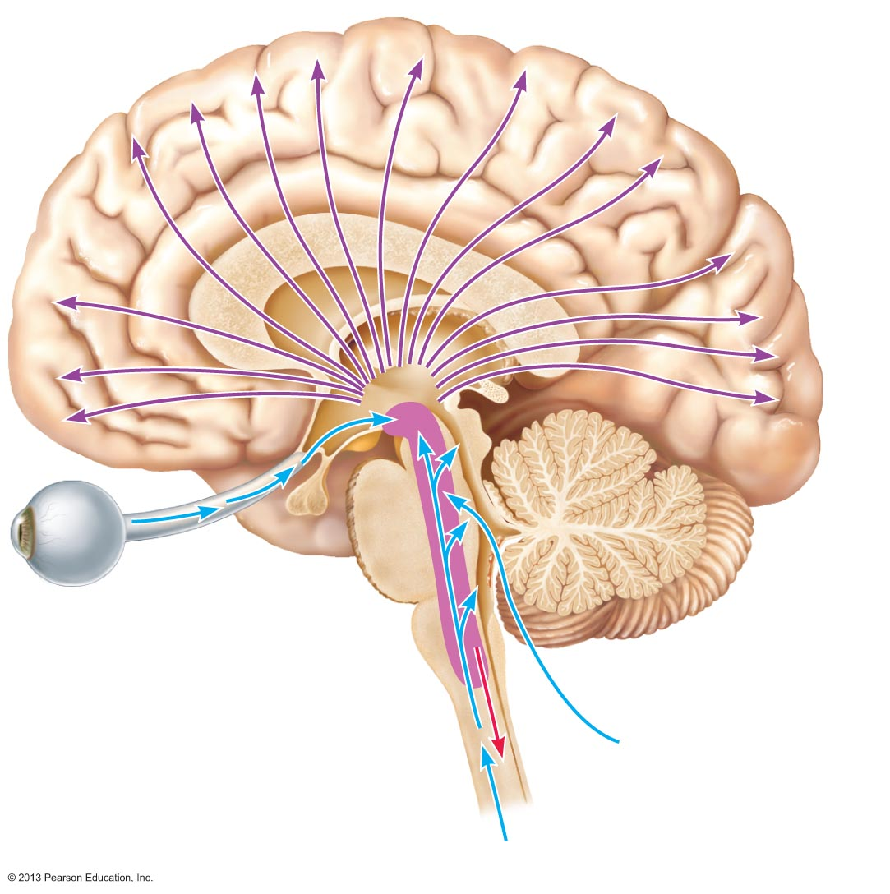
Figure 12.17 The reticular formation.
Radiations
to cerebral
cortex
Visual
impulses
Auditory
impulses
Reticular formation
Ascending general
sensory tracts
(touch, pain, temperature)
Descending
motor projections
to spinal cord

Slide 11
Brain Wave Patterns and the EEG
EEG = electroencephalogram
Records electrical activity that accompanies brain function
Measures electrical potential differences between various cortical areas

Slide 12
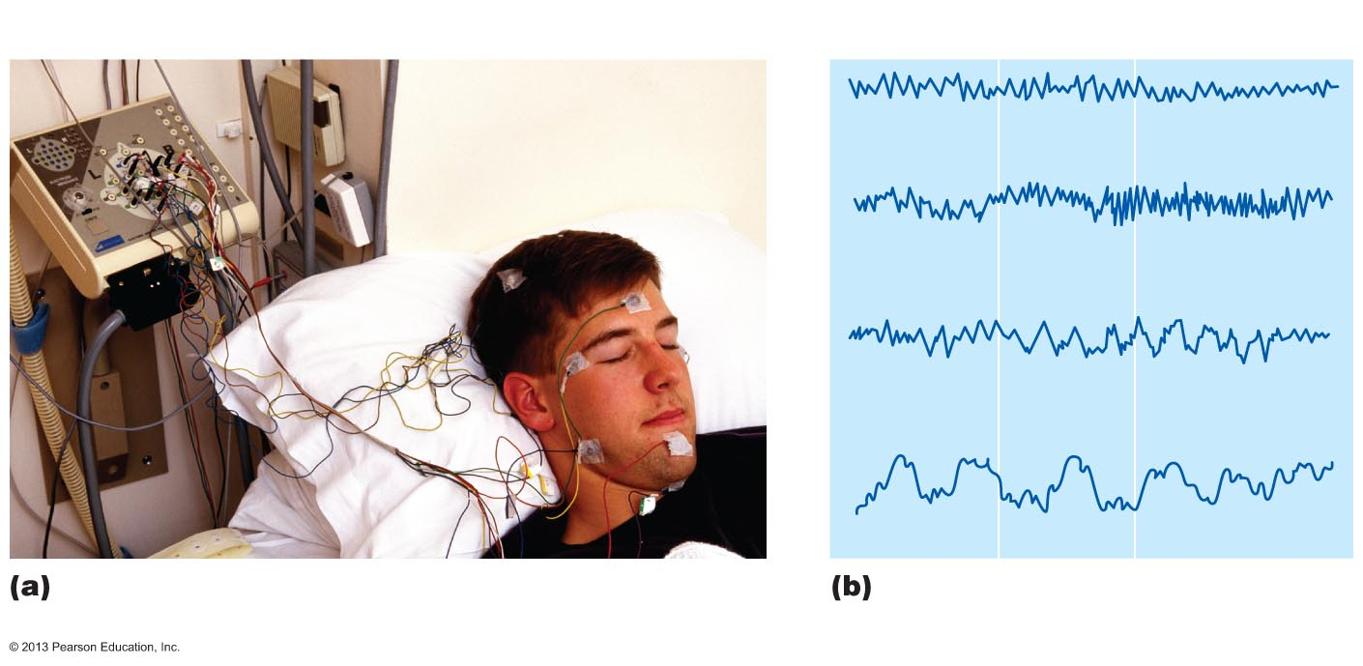
Figure 12.18 Electroencephalography (EEG) and brain waves.
1-second interval
Alpha waves—awake but relaxed
Beta waves—awake, alert
Theta waves—common in children
Delta waves—deep sleep
Scalp electrodes are used to record
brain wave activity.
Brain waves shown in EEGs
fall into four general classes.

Slide 13
Brain Waves
Patterns of neuronal electrical activity
Generated by synaptic activity in cortex
Each person's brain waves are unique
Can be grouped into four classes based on frequency measured as hertz (Hz)
  Alpha, beta, theta, and delta waves

Slide 14
Types of Brain Waves
Alpha waves (8–13 Hz)—regular and rhythmic, low-amplitude, synchronous waves indicating an "idling" brain
Beta waves (14–30 Hz)—rhythmic, less regular waves occurring when mentally alert
Theta waves (4–7 Hz)—more irregular; common in children and uncommon in awake adults
Delta waves (4 Hz or less)—high-amplitude waves of deep sleep and when reticular activating system is damped as during anesthesia; indicate brain damage in awake adult

Slide 15
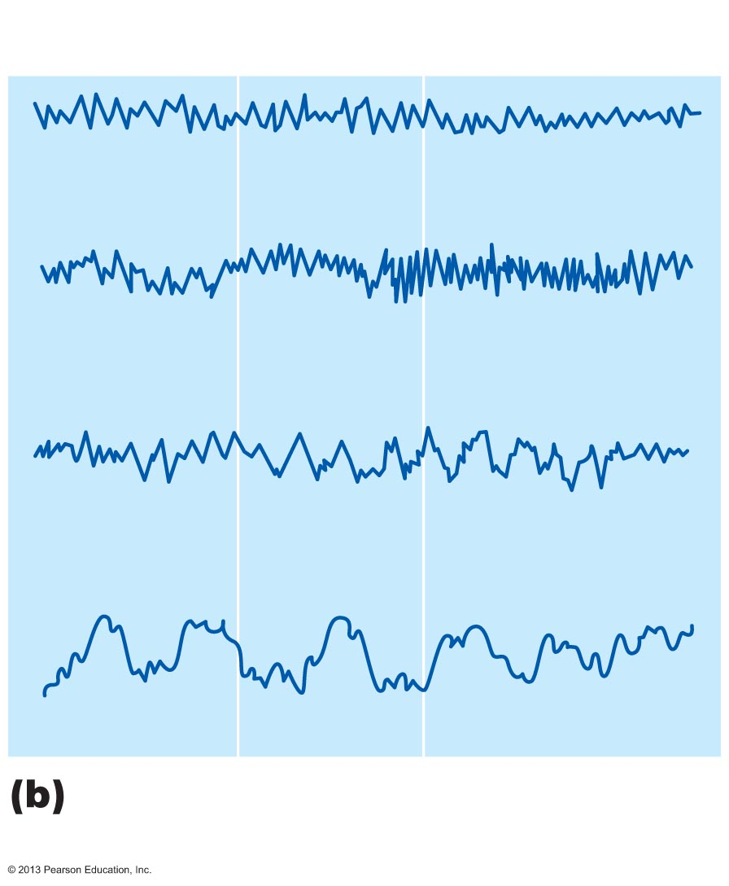
Figure 12.18b Electroencephalography (EEG) and brain waves.
1-second interval
Alpha waves—awake but relaxed
Beta waves—awake, alert
Theta waves—common in children
Delta waves—deep sleep
Brain waves shown in EEGs
fall into four general classes.

Slide 16
Brain Waves: State of the Brain
Change with age, sensory stimuli, brain disease, and chemical state of body
EEGs used to diagnose and localize brain lesions, tumors, infarcts, infections, abscesses, and epileptic lesions
Flat EEG (no electrical activity) is clinical evidence of brain death

Slide 17
Epilepsy
Victim of epilepsy may lose consciousness, fall stiffly, and have uncontrollable jerking
Epilepsy not associated with intellectual impairments
Epilepsy occurs in 1% of population
Aura (sensory hallucination) may precede seizure

Slide 18
Epileptic Seizures
Absence seizures (formerly petit mal)
  Mild seizures of young children - expression goes blank for few seconds
Tonic-clonic (formerly grand mal) seizures
  Most severe; last few minutes
  Victim loses consciousness, bones broken during intense convulsions, loss of bowel and bladder control, and severe biting of tongue

Slide 19
Control of Epilepsy
Anticonvulsive drugs
Vagus nerve stimulator or deep brain stimulator implanted
  Deliver pulses to vagus nerve or directly to brain to stabilize brain activity
Research into brain electrode implants to detect and prevent oncoming seizures

Slide 20
Consciousness
Conscious perception of sensation
Voluntary initiation and control of movement
Capabilities associated with higher mental processing (memory, logic, judgment, etc.)
Loss of consciousness signal that brain function impaired
  Fainting or syncopy – brief
  Coma – extended period

Slide 21
Consciousness
Clinically defined on continuum that grades behavior in response to stimuli
  Alertness, drowsiness (lethargy), stupor, coma
  Involves simultaneous activity of large cortical areas
  Superimposed on other neural activities
  Holistic and totally interconnected

Slide 22
Sleep and Sleep-Wake Cycles
State of partial unconsciousness from which person can be aroused by stimulation
Two major types of sleep (defined by EEG patterns)
  Non-rapid eye movement (NREM) sleep
  Rapid eye movement (REM) sleep

Slide 23
Sleep
Pass through first two stages of NREM and into stages 3 and 4 (slow-wave sleep) during the first 30–45 minutes of sleep
At ~ 90 minutes, after fourth stage, REM sleep begins abruptly
  EEG, heart rate, respiratory rate, blood pressure, and GI motility change
  Temporary paralysis

Slide 24
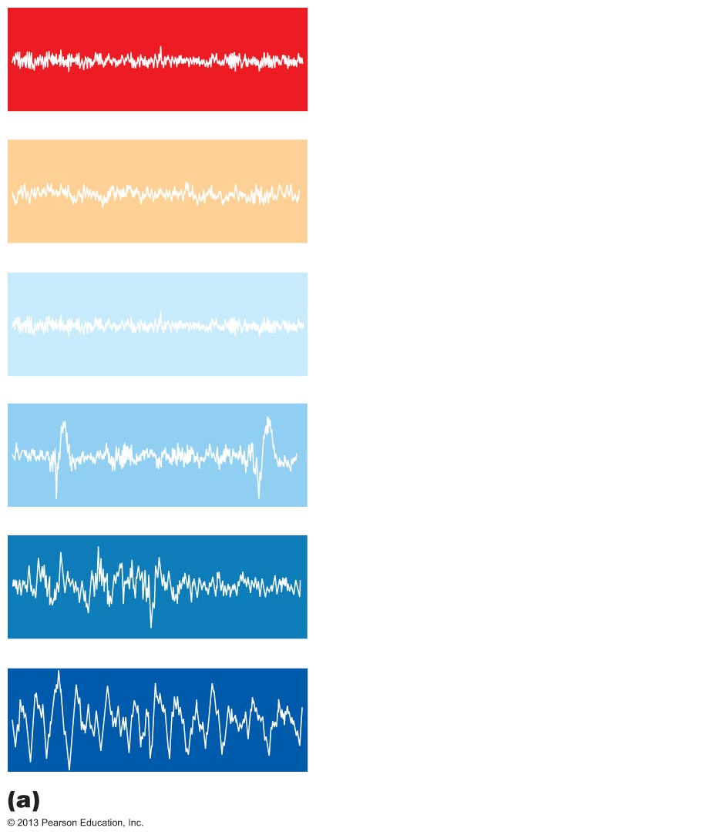
Figure 12.19a Types and stages of sleep.
Awake
REM: Skeletal muscles (except
ocular muscles and diaphragm)
are actively inhibited; most
dreaming occurs.
NREM stage 1: Relaxation
begins; EEG shows alpha waves;
arousal is easy.
NREM stage 2: Irregular EEG
with sleep spindles (short high-
amplitude bursts); arousal is more
difficult.
NREM stage 3: Sleep deepens;
theta and delta waves appear; vital
signs decline.
NREM stage 4: EEG is
dominated by delta waves;
arousal is difficult; bed-wetting,
night terrors, and sleepwalking
may occur.
Typical EEG patterns

Slide 25
Sleep Patterns
Alternating cycles of sleep and wakefulness reflect natural circadian (24-hour) rhythm
RAS activity inhibited during, but RAS also mediates sleep stages
Suprachiasmatic and preoptic nuclei of hypothalamus time sleep cycle
Typical sleep pattern alternates between REM and NREM sleep

Slide 26
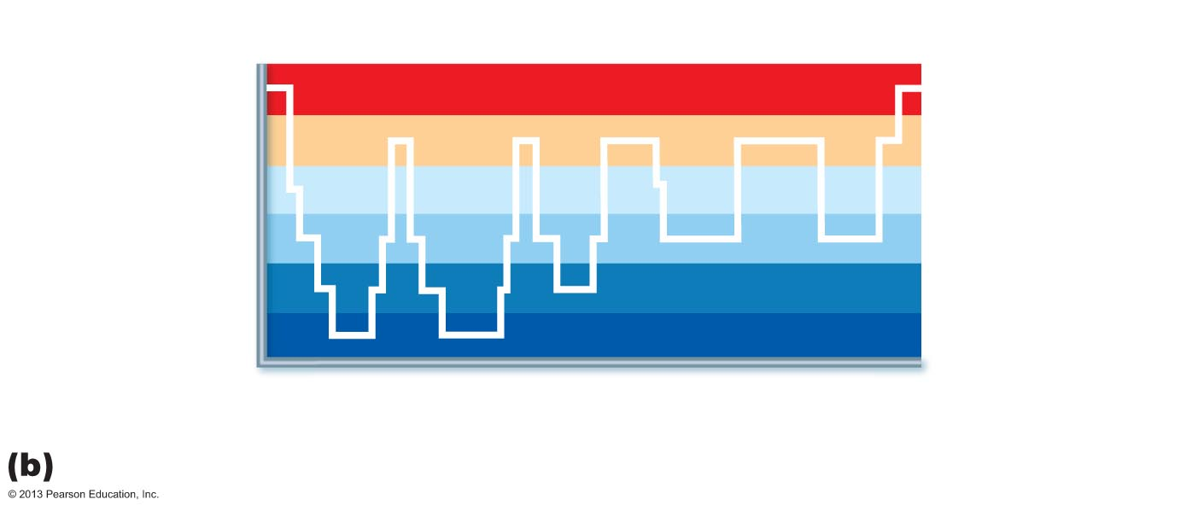
Figure 12.19b Types and stages of sleep.
Awake
REM
Stage 1
Stage 2
NREM
Stage 3
Stage 4
1
2
3
4
5
6
7
Time (hrs)
Typical progression of an adult through one night’s sleep stages

Slide 27
Importance of Sleep
Slow-wave sleep (NREM stages 3 and 4) presumed to be restorative stage
People deprived of REM sleep become moody and depressed
REM sleep may be reverse learning process where superfluous information purged from brain
Daily sleep requirements decline with age
Stage 4 sleep declines steadily and may disappear after age 60

Slide 28
Sleep Disorders
Narcolepsy
  Abrupt lapse into sleep from awake state
  Often have cataplexy
    Sudden loss of voluntary muscle control
  Orexins ("wake-up" chemicals from hypothalamus) destroyed by immune system
    Key to possible treatment

Slide 29
Sleep Disorders
Insomnia
  Chronic inability to obtain amount or quality of sleep needed
  May be treated by blocking orexin action
Sleep apnea
  Temporary cessation of breathing during sleep
  Causes hypoxia

Slide 30
Language
Language implementation system
  Basal nuclei
  Broca's area and Wernicke's area (in association cortex on left side)
  Analyzes incoming word sounds
  Produces outgoing word sounds and grammatical structures
Corresponding areas on right side are involved with nonverbal language components

Slide 31
Memory
Storage and retrieval of information
Two stages of storage
  Short-term memory (STM, or working memory)—temporary holding of information; limited to seven or eight pieces of information
  Long-term memory (LTM) has limitless capacity

Slide 32
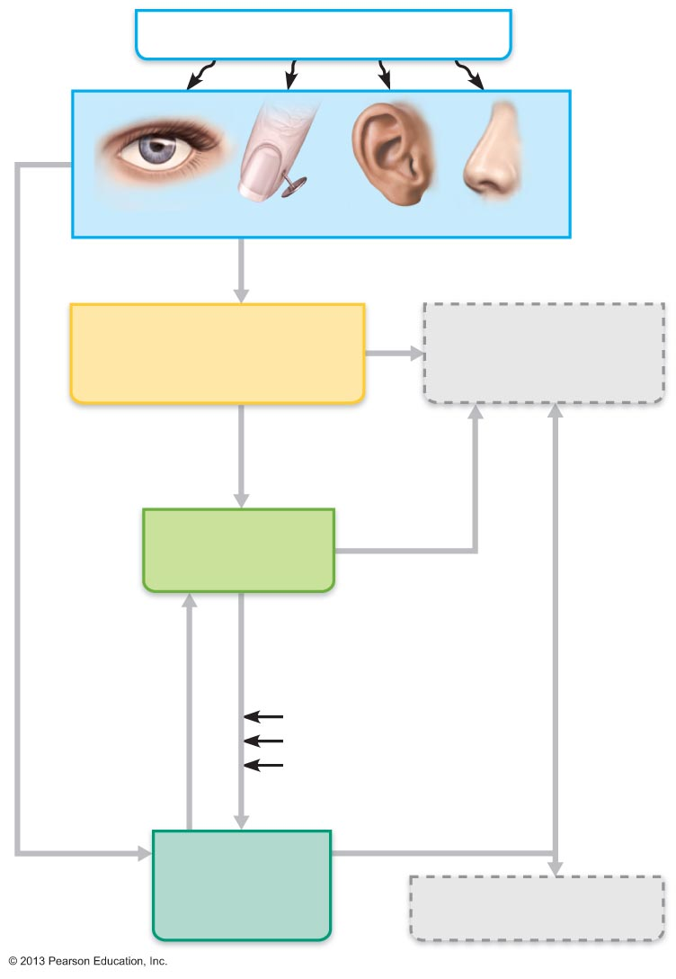
Figure 12.20 Memory processing.
Outside stimuli
General and special sensory receptors
Afferent inputs
Temporary storage
(buffer) in cerebral
cortex
Data permanently
lost
Automatic
memory
Data selected
for transfer
Forget
Short-term
memory (STM)
Forget
Data transfer
influenced by:
Retrieval
Excitement
Rehearsal
Associating new
data with stored data
Long-term
memory
(LTM)
Data unretrievable

Slide 33
Transfer from STM to LTM
Factors affecting transfer from STM to LTM
  Emotional state—best if alert, motivated, surprised, and aroused
  Rehearsal—repetition and practice
  Association—tying new information with old memories
  Automatic memory—subconscious information stored in LTM

Slide 34
Categories of Memory
Declarative (fact) memory
  Explicit information
  Related to conscious thoughts and language ability
  Stored in LTM with context in which learned

Slide 35
Categories of Memory
Nondeclarative memory
  Less conscious or unconscious
  Acquired through experience and repetition
  Best remembered by doing; hard to unlearn
  Includes procedural (skills) memory, motor memory, and emotional memory

Slide 36
Brain Structures Involved in Memory
Hippocampus and surrounding temporal lobes function in consolidation and access to memory
ACh from basal forebrain is necessary for memory formation and retrieval

Slide 37
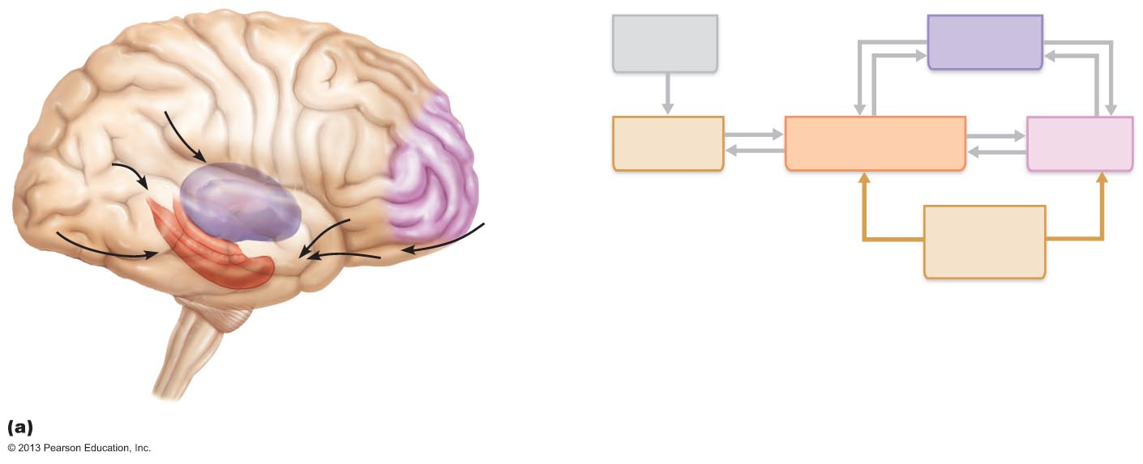
Figure 12.21a Proposed memory circuits.
Thalamus
Sensory
input
Thalamus
Basal
forebrain
Touch
Prefrontal
cortex
Association
cortex
Medial temporal lobe
(hippocampus, etc.)
Prefrontal
cortex
Hearing
Vision
Taste
Smell
ACh released
by basal
forebrain
Hippocampus
Declarative memory circuits

Slide 38
Brain Structures Involved in Memory
Procedural memory
  Basal nuclei relay sensory and motor inputs to thalamus and premotor cortex
  Dopamine from substantia nigra is necessary
Motor memory—cerebellum
Emotional memory—amygdaloid body

Slide 39
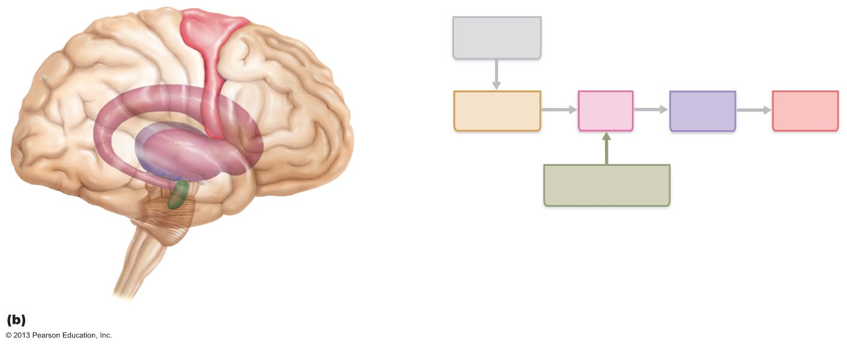
Figure 12.21b Proposed memory circuits.
Premotor
cortex
Sensory and
motor inputs
Association
cortex
Basal
nuclei
Thalamus
Premotor
cortex
Dopamine released
by substantia nigra
Thalamus
Basal
nuclei
Substantia
nigra
Procedural (skills) memory circuits

Slide 40
Molecular Basis of Memory
During learning:
  Neuronal RNA altered; newly synthesized mRNA moved to axons and dendrites
  Dendritic spines change shape
  Extracellular proteins deposited at synapses involved in LTM
  Number and size of presynaptic terminals may increase
  Presynaptic neurons release more neurotransmitter

Slide 41
Molecular Basis of Memory
Long-term potentiation (LTP)
  Increase in synaptic strength crucial
Neurotransmitter (glutamate) binds to NMDA receptors, opening calcium channels in postsynaptic terminal

Slide 42
Molecular Basis of Memory
Calcium influx activates enzymes that
  Modify proteins of pre- and postsynaptic terminal
  Activate postsynaptic neuron to synthesize synaptic proteins in response to cAMP response-element binding protein (CREB); BDNF (brain-derived neurotrophic factor) required for protein synthesis phase of LTP
  Believe long-lasting synaptic strength increases underlie memory formation

Slide 43
Protection of the Brain
Bone (skull)
Membranes (meninges)
Watery cushion (cerebrospinal fluid)
Blood brain barrier

Slide 44
Meninges
Cover and protect CNS
Protect blood vessels and enclose venous sinuses
Contain cerebrospinal fluid (CSF)
Form partitions in skull

Slide 45
Meninges
Three layers
  Dura mater
  Arachnoid mater
  Pia mater
Meningitis
  Inflammation of meninges

Slide 46
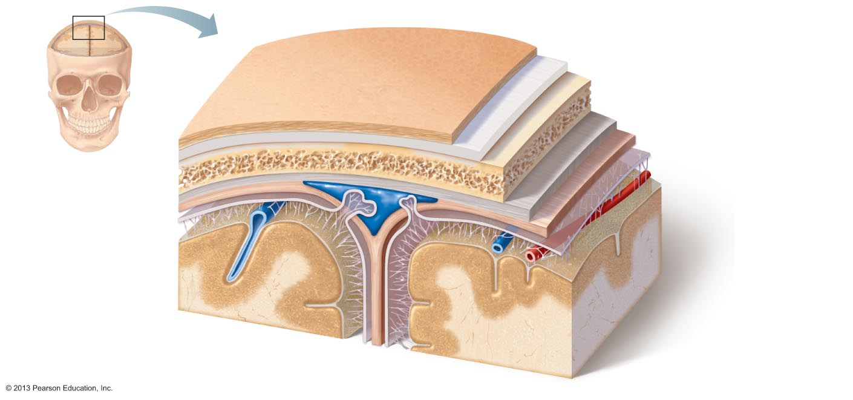
Figure 12.22 Meninges: dura mater, arachnoid mater, and pia mater.
Skin of scalp
Periosteum
Bone of skull
Dura mater
• Periosteal layer
Superior sagittal
sinus
• Meningeal layer
Arachnoid mater
Subdural
space
Pia mater
Arachnoid villus
Subarachnoid
space
Blood vessel
Falx cerebri
(in longitudinal
fissure only)

Slide 47
Dura Mater
Strongest meninx
Two layers of fibrous connective tissue (around brain) separate to form dural venous sinuses

Slide 48
Dura Mater
Dural septa limit excessive movement of brain
  Falx cerebri—in longitudinal fissure; attached to crista galli
  Falx cerebelli—along vermis of cerebellum
  Tentorium cerebelli—horizontal dural fold over cerebellum and in transverse fissure

Slide 49
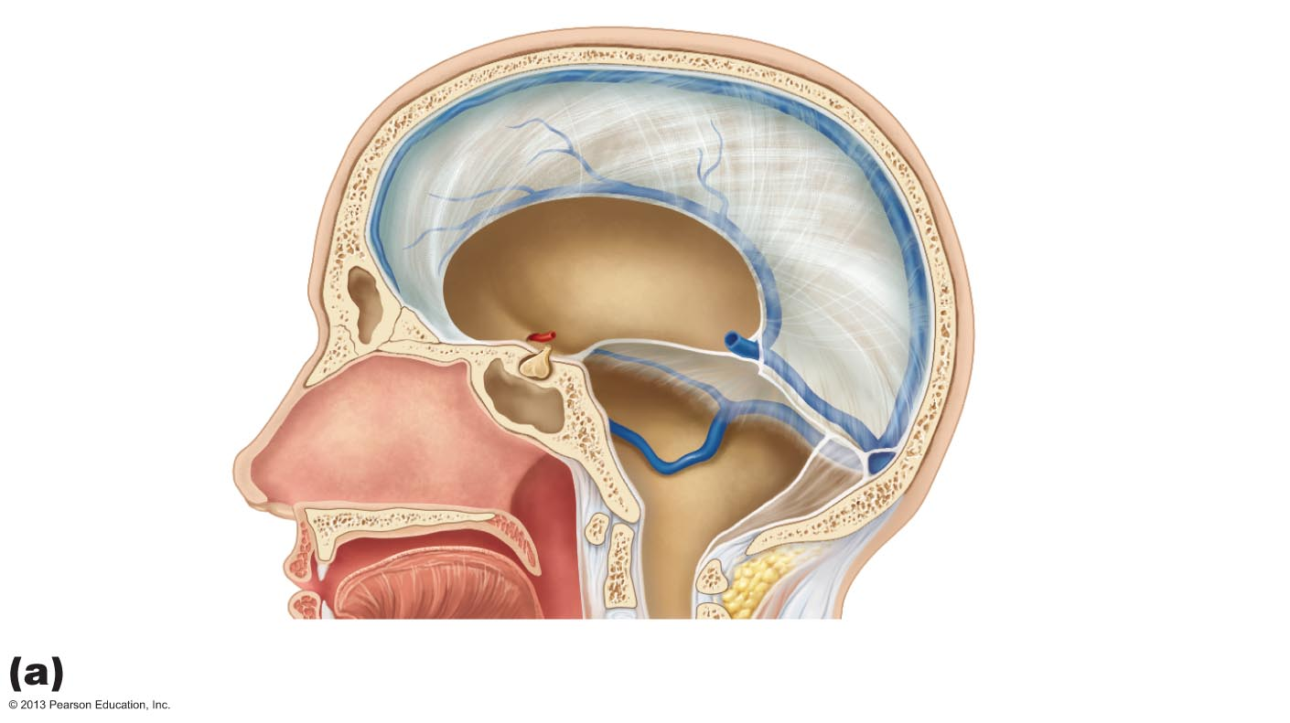
Figure 12.23a Dural septa and dural venous sinuses.
Superior
sagittal sinus
Falx cerebri
Straight
sinus
Tentorium
cerebelli
Crista galli of
the ethmoid
bone
Falx
cerebelli
Pituitary
gland
Midsagittal view

Slide 50
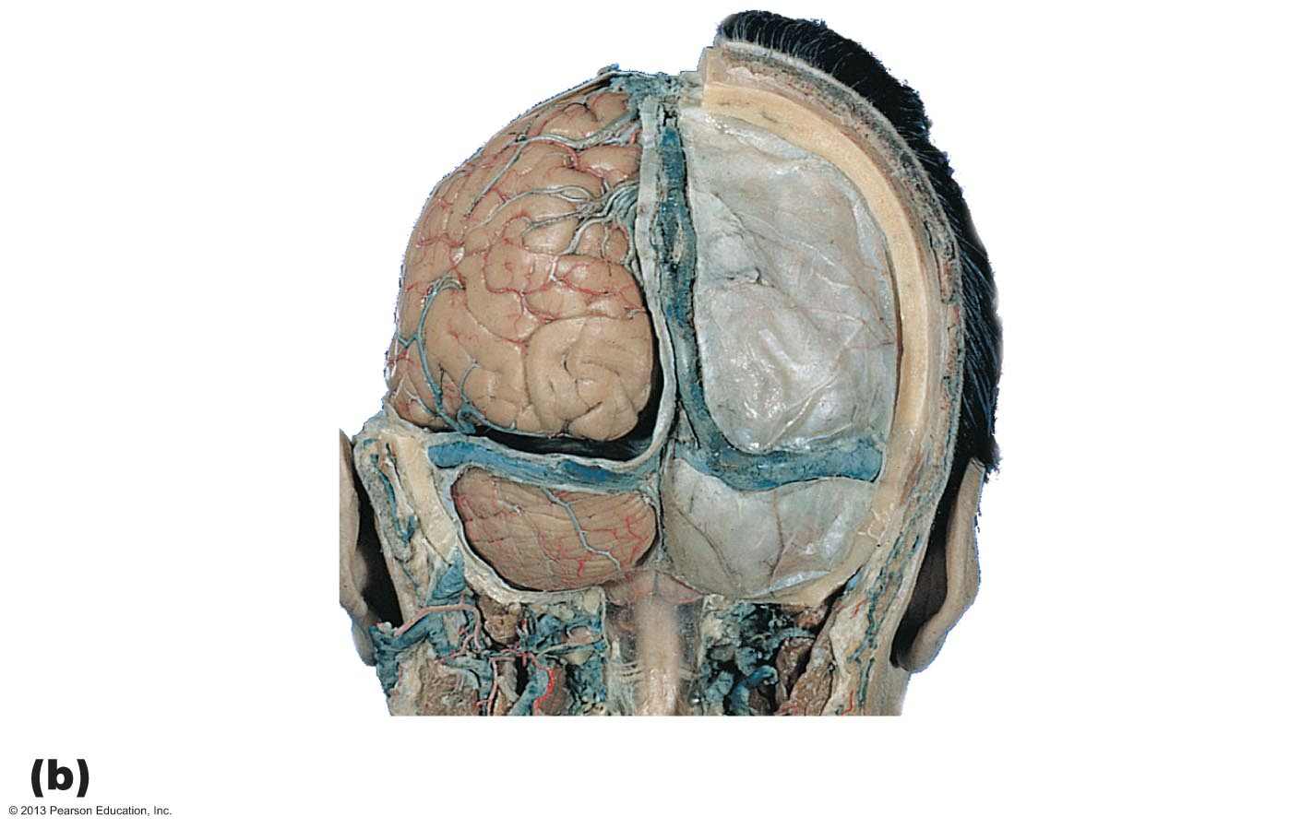
Figure 12.23b Dural septa and dural venous sinuses.
Superior
sagittal sinus
Parietal
bone
Scalp
Falx cerebri
Occipital lobe
Tentorium
cerebelli
Dura mater
Falx
cerebelli
Transverse
sinus
Cerebellum
Temporal
bone
Arachnoid
mater over
medulla oblongata
Posterior dissection

Slide 51
Arachnoid Mater
Middle layer with weblike extensions
Separated from dura mater by subdural space
Subarachnoid space contains CSF and largest blood vessels of brain
Arachnoid villi protrude into superior sagittal sinus and permit CSF reabsorption

Slide 52
Figure 12.22 Meninges: dura mater, arachnoid mater, and pia mater.
Skin of scalp
Periosteum
Bone of skull
Dura mater
• Periosteal layer
Superior sagittal
sinus
• Meningeal layer
Arachnoid mater
Subdural
space
Pia mater
Arachnoid villus
Subarachnoid
space
Blood vessel
Falx cerebri
(in longitudinal
fissure only)

Slide 53
Pia Mater
Delicate vascularized connective tissue that clings tightly to brain

Slide 54
Cerebrospinal Fluid (CSF)
Composition
  Watery solution formed from blood plasma
    Less protein and different ion concentrations than plasma
  Constant volume

Slide 55
Cerebrospinal Fluid (CSF)
Functions
  Gives buoyancy to CNS structures
    Reduces weight by 97%
  Protects CNS from blows and other trauma
  Nourishes brain and carries chemical signals

Slide 56
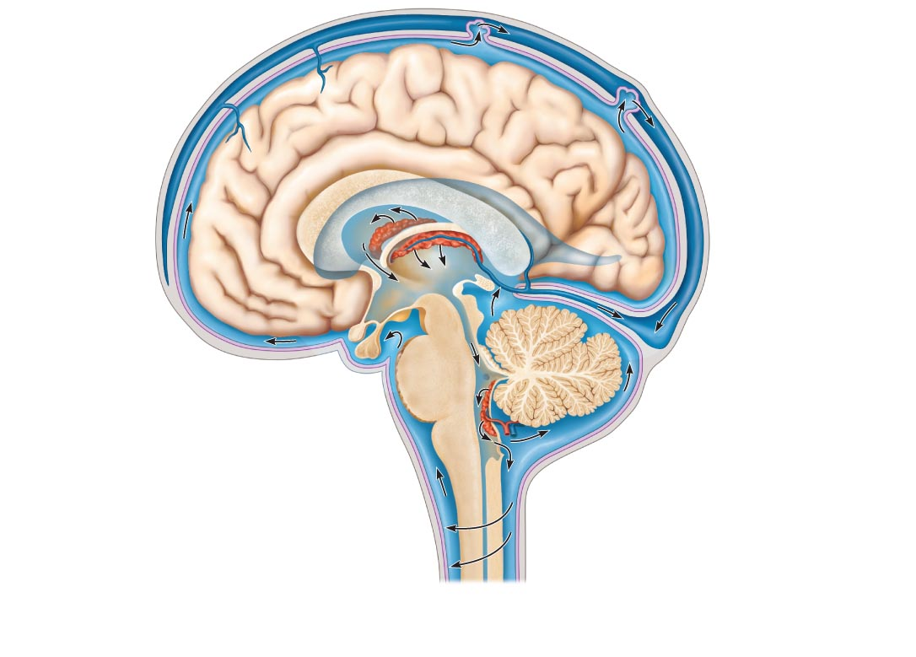
Figure 12.24a Formation, location, and circulation of CSF.
Slide 1
4
Superior
sagittal sinus
Arachnoid villus
Choroid plexus
Subarachnoid space
Arachnoid mater
Meningeal dura mater
Periosteal dura mater
1
Interventricular
foramen
Right lateral ventricle
(deep to cut)
Third ventricle
3
Choroid plexus
of fourth ventricle
Cerebral aqueduct
Lateral aperture
Fourth ventricle
1 The choroid plexus of each
Ventricle produces CSF.
Median aperture
2
2 CSF flows through the ventricles
and into the subarachnoid space via
the median and lateral apertures.
Central canal
of spinal cord
3 CSF flows through the
subarachnoid space.
(a) CSF circulation
4 CSF is absorbed into the dural
venous sinuses via the arachnoid villi.

Slide 57
Figure 12.24a Formation, location, and circulation of CSF.
Slide 2
Superior
sagittal sinus
Arachnoid villus
Choroid plexus
Subarachnoid space
Arachnoid mater
Meningeal dura mater
Periosteal dura mater
1
Interventricular
foramen
Right lateral ventricle
(deep to cut)
Third ventricle
Choroid plexus
of fourth ventricle
Cerebral aqueduct
Lateral aperture
Fourth ventricle
1 The choroid plexus of each
Ventricle produces CSF.
Median aperture
Central canal
of spinal cord
(a) CSF circulation

Slide 58
Figure 12.24a Formation, location, and circulation of CSF.
Slide 3
Superior
sagittal sinus
Arachnoid villus
Choroid plexus
Subarachnoid space
Arachnoid mater
Meningeal dura mater
Periosteal dura mater
1
Interventricular
foramen
Right lateral ventricle
(deep to cut)
Third ventricle
Choroid plexus
of fourth ventricle
Cerebral aqueduct
Lateral aperture
Fourth ventricle
1 The choroid plexus of each
Ventricle produces CSF.
Median aperture
2
2 CSF flows through the ventricles
and into the subarachnoid space via
the median and lateral apertures.
Central canal
of spinal cord
(a) CSF circulation

Slide 59
Figure 12.24a Formation, location, and circulation of CSF.
Slide 4
Superior
sagittal sinus
Arachnoid villus
Choroid plexus
Subarachnoid space
Arachnoid mater
Meningeal dura mater
Periosteal dura mater
1
Interventricular
foramen
Right lateral ventricle
(deep to cut)
Third ventricle
3
Choroid plexus
of fourth ventricle
Cerebral aqueduct
Lateral aperture
Fourth ventricle
1 The choroid plexus of each
Ventricle produces CSF.
Median aperture
2
2 CSF flows through the ventricles
and into the subarachnoid space via
the median and lateral apertures.
Central canal
of spinal cord
3 CSF flows through the
subarachnoid space.
(a) CSF circulation

Slide 60
Figure 12.24a Formation, location, and circulation of CSF.
Slide 5
4
Superior
sagittal sinus
Arachnoid villus
Choroid plexus
Subarachnoid space
Arachnoid mater
Meningeal dura mater
Periosteal dura mater
1
Interventricular
foramen
Right lateral ventricle
(deep to cut)
Third ventricle
3
Choroid plexus
of fourth ventricle
Cerebral aqueduct
Lateral aperture
Fourth ventricle
1 The choroid plexus of each
Ventricle produces CSF.
Median aperture
2
2 CSF flows through the ventricles
and into the subarachnoid space via
the median and lateral apertures.
Central canal
of spinal cord
3 CSF flows through the
subarachnoid space.
(a) CSF circulation
4 CSF is absorbed into the dural
venous sinuses via the arachnoid villi.

Slide 61
Choroid Plexuses
Hang from roof of each ventricle; produce CSF at constant rate; keep in motion
  Clusters of capillaries enclosed by pia mater and layer of ependymal cells
Ependymal cells use ion pumps to control composition of CSF and help cleanse CSF by removing wastes
Normal volume ~ 150 ml; replaced every 8 hours

Slide 62
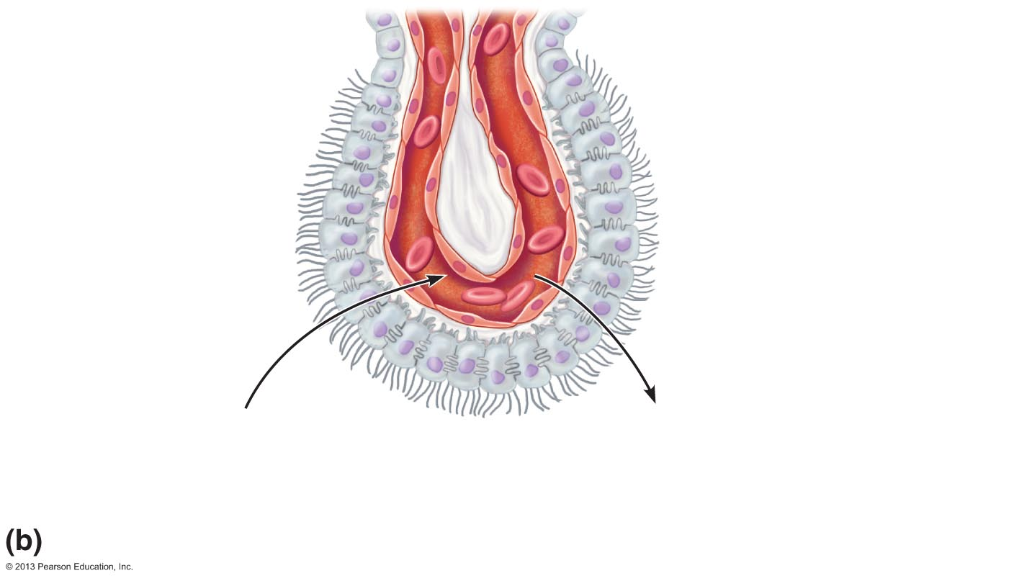
Figure 12.24b Formation, location, and circulation of CSF.
Ependymal
cells
Capillary
Section
of choroid
plexus
Connective
tissue of
pia mater
Wastes and
unnecessary
solutes absorbed
CSF forms as a filtrate
containing glucose, oxygen,
vitamins, and ions
(Na⁺, Cl–, Mg²⁺, etc.)
Cavity of
ventricle
CSF formation by choroid plexuses

Slide 63
Hydrocephalus
Obstruction blocks CSF circulation or drainage
Unfused skull bones of newborn allow enlargement of head
Brain damage in adult due to rigid adult skull
Treated by draining with ventricular shunt to abdominal cavity

Slide 64
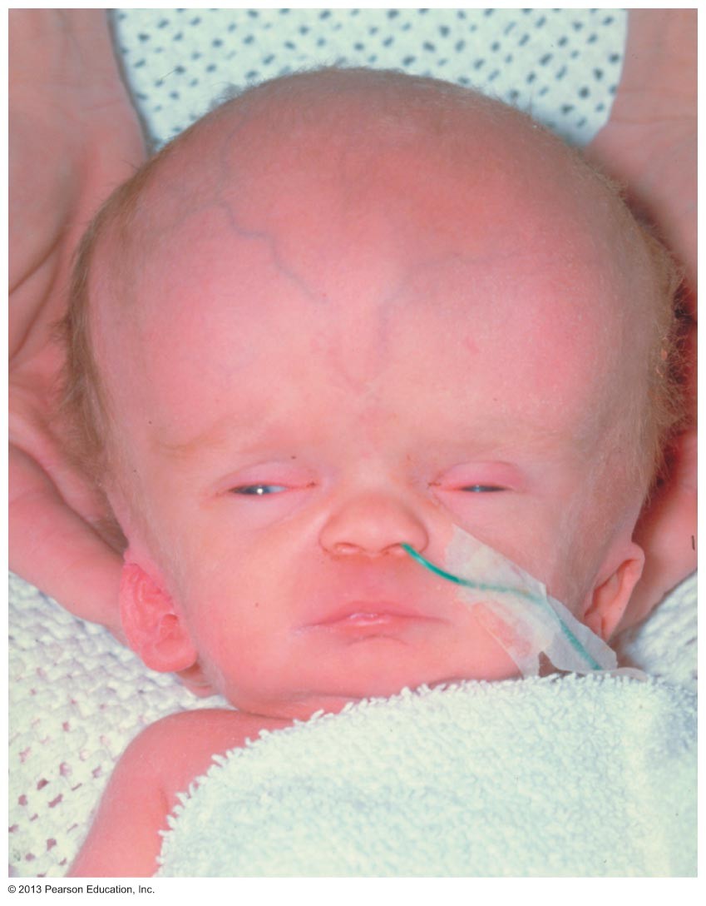
Figure 12.25 Hydrocephalus in a newborn.

Slide 65
Blood Brain Barrier
Helps maintain stable environment for brain
Separates neurons from some bloodborne substances

Slide 66
Blood Brain Barrier
Composition
  Continuous endothelium of capillary walls
  Thick basal lamina around capillaries
  Feet of astrocytes
    Provide signal to endothelium for formation of tight junctions

Slide 67
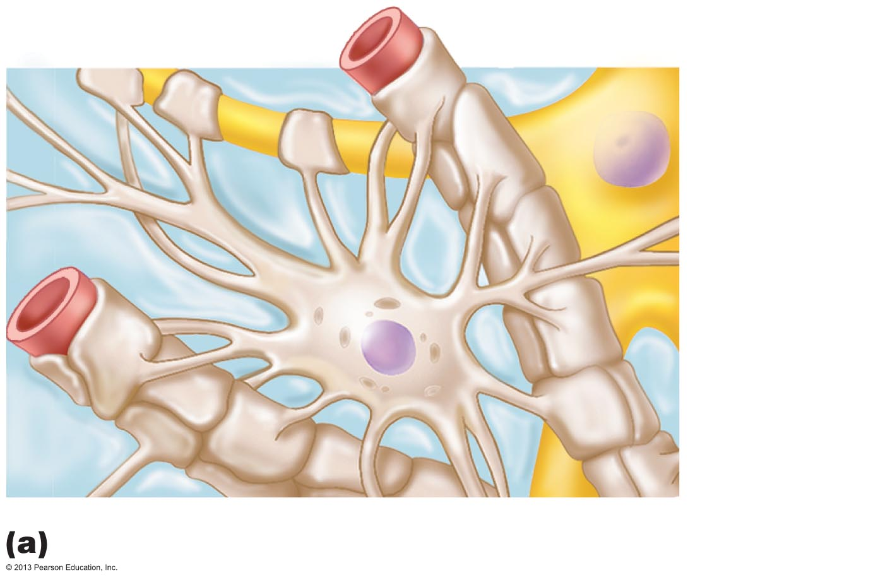
Figure 11.3a Neuroglia.
Capillary
Neuron
Astrocyte
Astrocytes are the most abundant CNS neuroglia.

Slide 68
Blood Brain Barrier: Functions
Selective barrier
  Allows nutrients to move by facilitated diffusion
  Metabolic wastes, proteins, toxins, most drugs, small nonessential amino acids, K⁺ denied
  Allows any fat-soluble substances to pass, including alcohol, nicotine, and anesthetics
Absent in some areas, e.g., vomiting center and hypothalamus, where necessary to monitor chemical composition of blood

Slide 69
Homeostatic Imbalances of the Brain
Traumatic brain injuries
  Concussion—temporary alteration in function
  Contusion—permanent damage
  Subdural or subarachnoid hemorrhage—may force brain stem through foramen magnum, resulting in death
  Cerebral edema—swelling of brain associated with traumatic head injury

Slide 70
Homeostatic Imbalances of the Brain
Cerebrovascular accidents (CVAs or strokes)
  Ischemia
    Tissue deprived of blood supply; brain tissue dies, e.g., blockage of cerebral artery by blood clot
  Hemiplegia (paralysis on one side), or sensory and speech deficits
  Transient ischemic attacks (TIAs)—temporary episodes of reversible cerebral ischemia
  Tissue plasminogen activator (TPA) is only approved treatment for stroke

Slide 71
Homeostatic Imbalances of the Brain
Degenerative brain disorders
  Alzheimer's disease (AD): a progressive degenerative disease of brain that results in dementia
    Memory loss, short attention span, disorientation, eventual language loss, irritable, moody, confused, hallucinations
    Plaques of beta-amyloid peptide form in brain
      Toxic effects may involve prion proteins
    Neurofibrillary tangles inside neurons kill them
    Brain shrinks

Slide 72
Homeostatic Imbalances of the Brain
Parkinson's disease
  Degeneration of dopamine-releasing neurons of substantia nigra
  Basal nuclei deprived of dopamine become overactive → tremors at rest
  Cause unknown
    Mitochondrial abnormalities or protein degradation pathways?
  Treatment with L-dopa; deep brain stimulation; gene therapy; research into stem cell transplants promising

Slide 73
Homeostatic Imbalances of the Brain
Huntington's disease
  Fatal hereditary disorder
  Caused by accumulation of protein huntingtin
    Leads to degeneration of basal nuclei and cerebral cortex
Initial symptoms wild, jerky "flapping" movements
Later marked mental deterioration
Treated with drugs that block dopamine effects
Stem cell implant research promising

